Slide 1

DATA VISUALIZATION WITH TABLEAU
PROJECT 3
- KAMINI NAYYAR

Slide 2

OPTION -2 AIRBNB_NYC
My friend Cecilia, is looking into investing in private property around NYC which she want to use it as an AIRBNB eventually.

Slide 3







Initial thoughts and questions:
Q1: Where can she get the most of her investment?/which area to use?
Q2: Which house type/property type she should invest in according to the trend?
Q3: Does she have many competitors around? And if yes, how can she list so she can get more value?
Q4: Which neighborhood people invest more money?
Q5: What would be the future trend if she invests in the property?

Slide 4
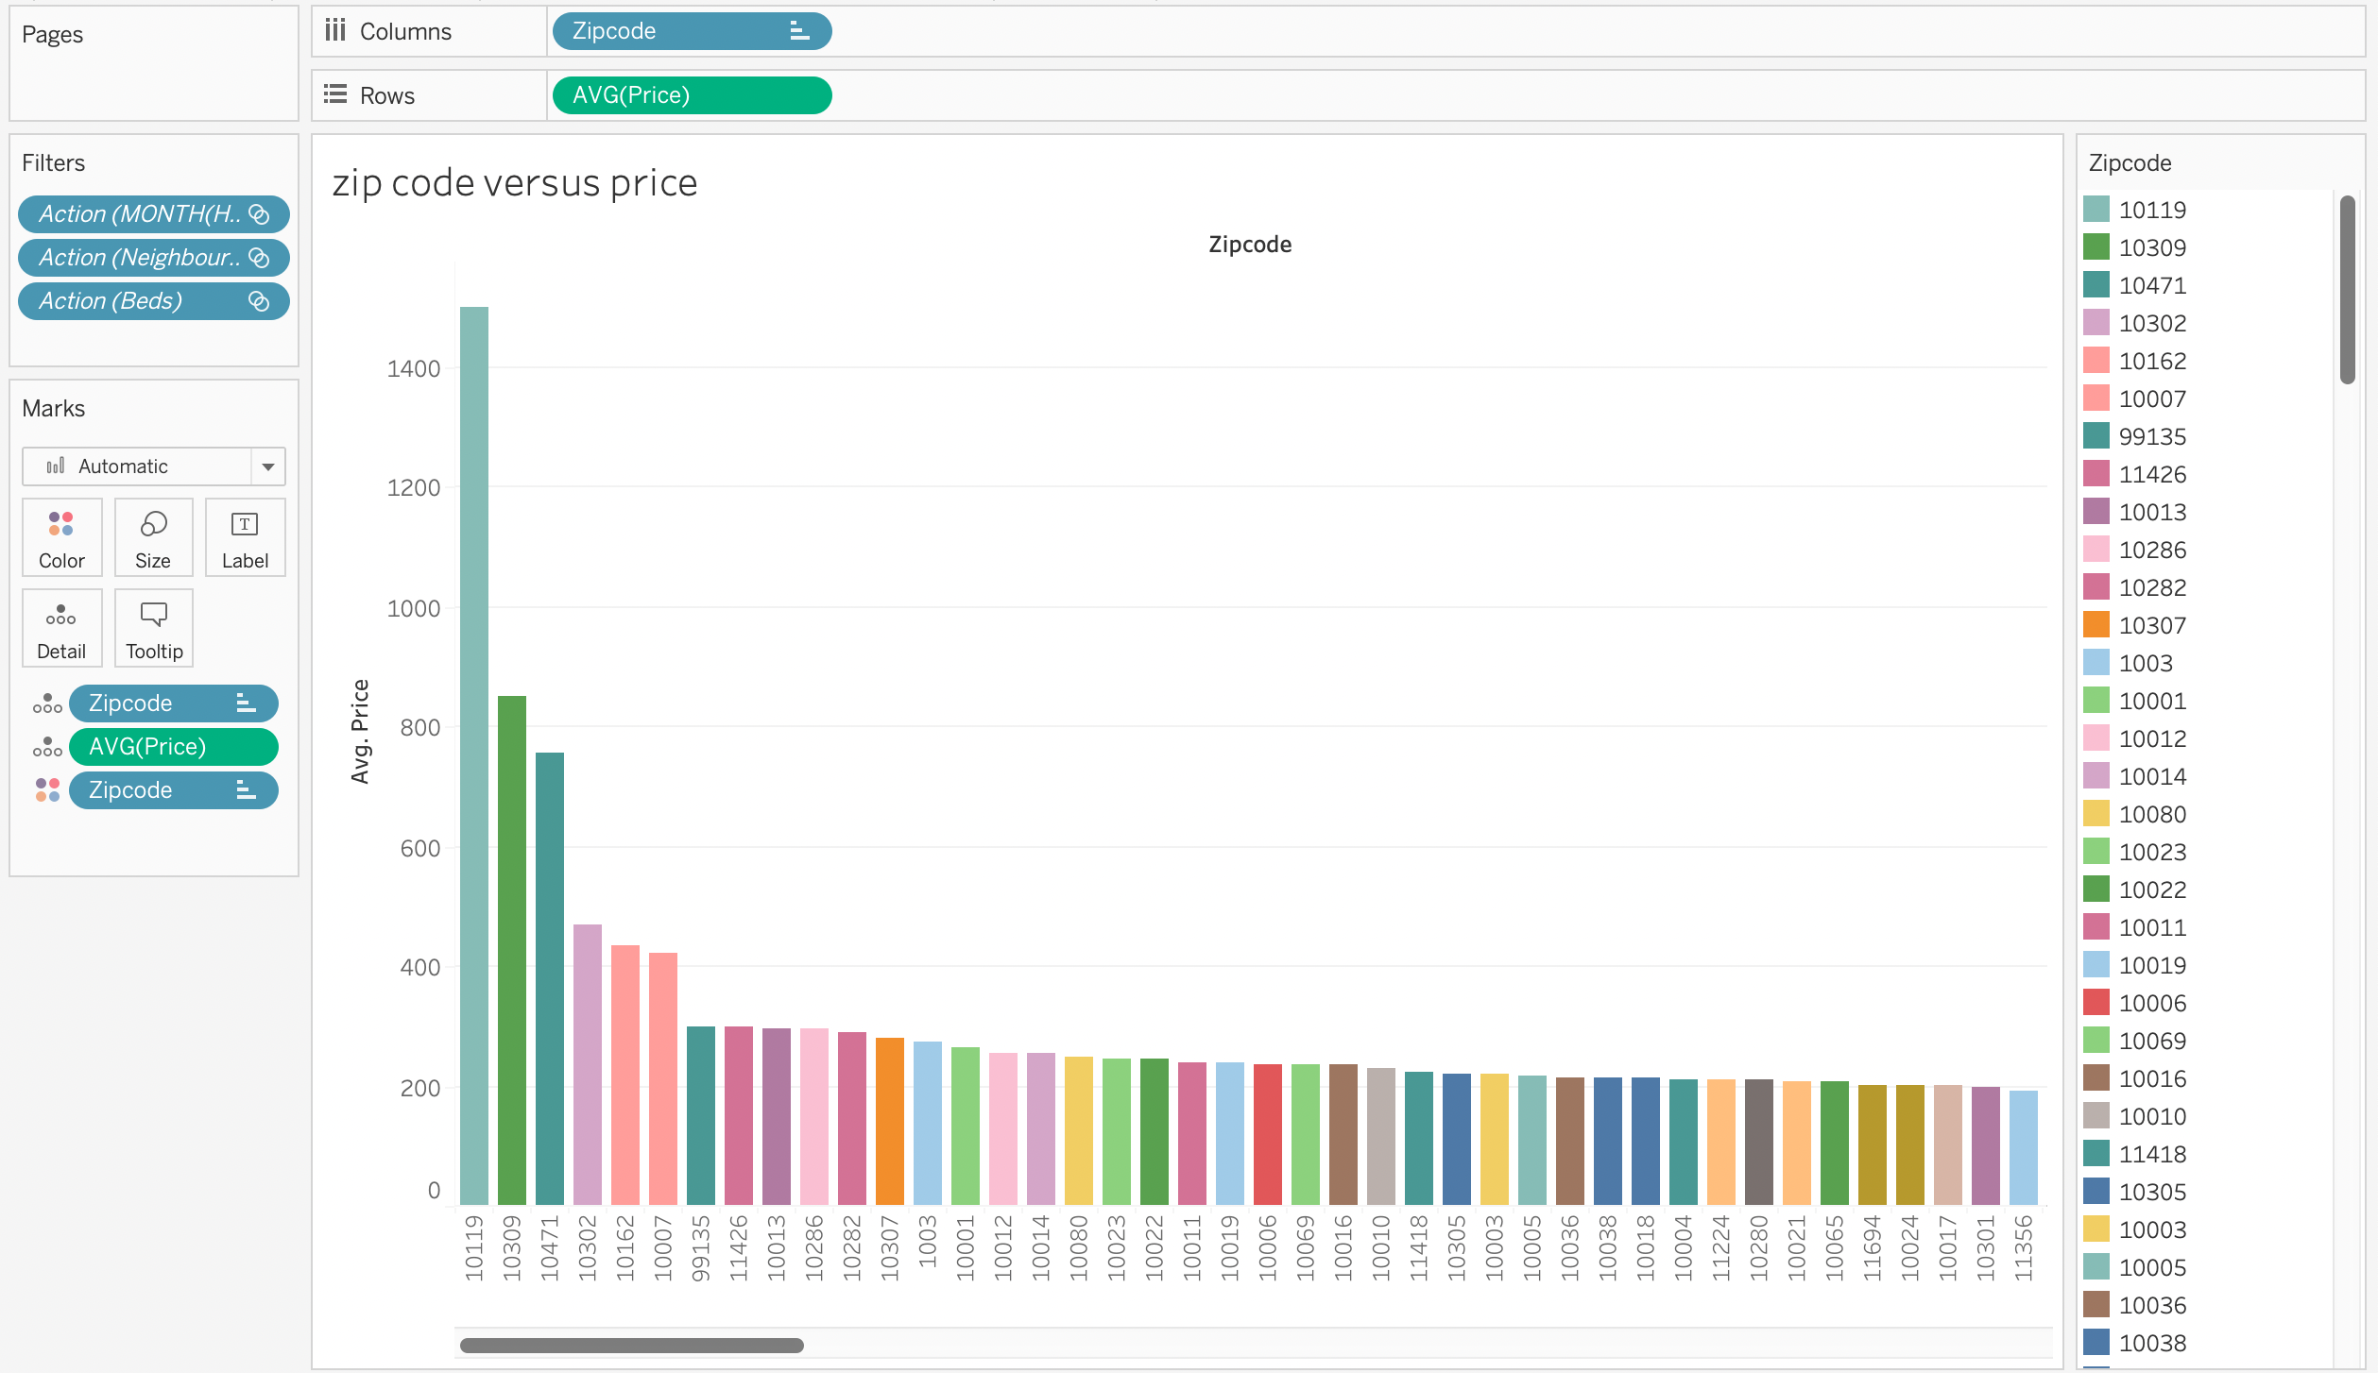
1st Visualization:
Which Zip code has the highest listing price?

Slide 5
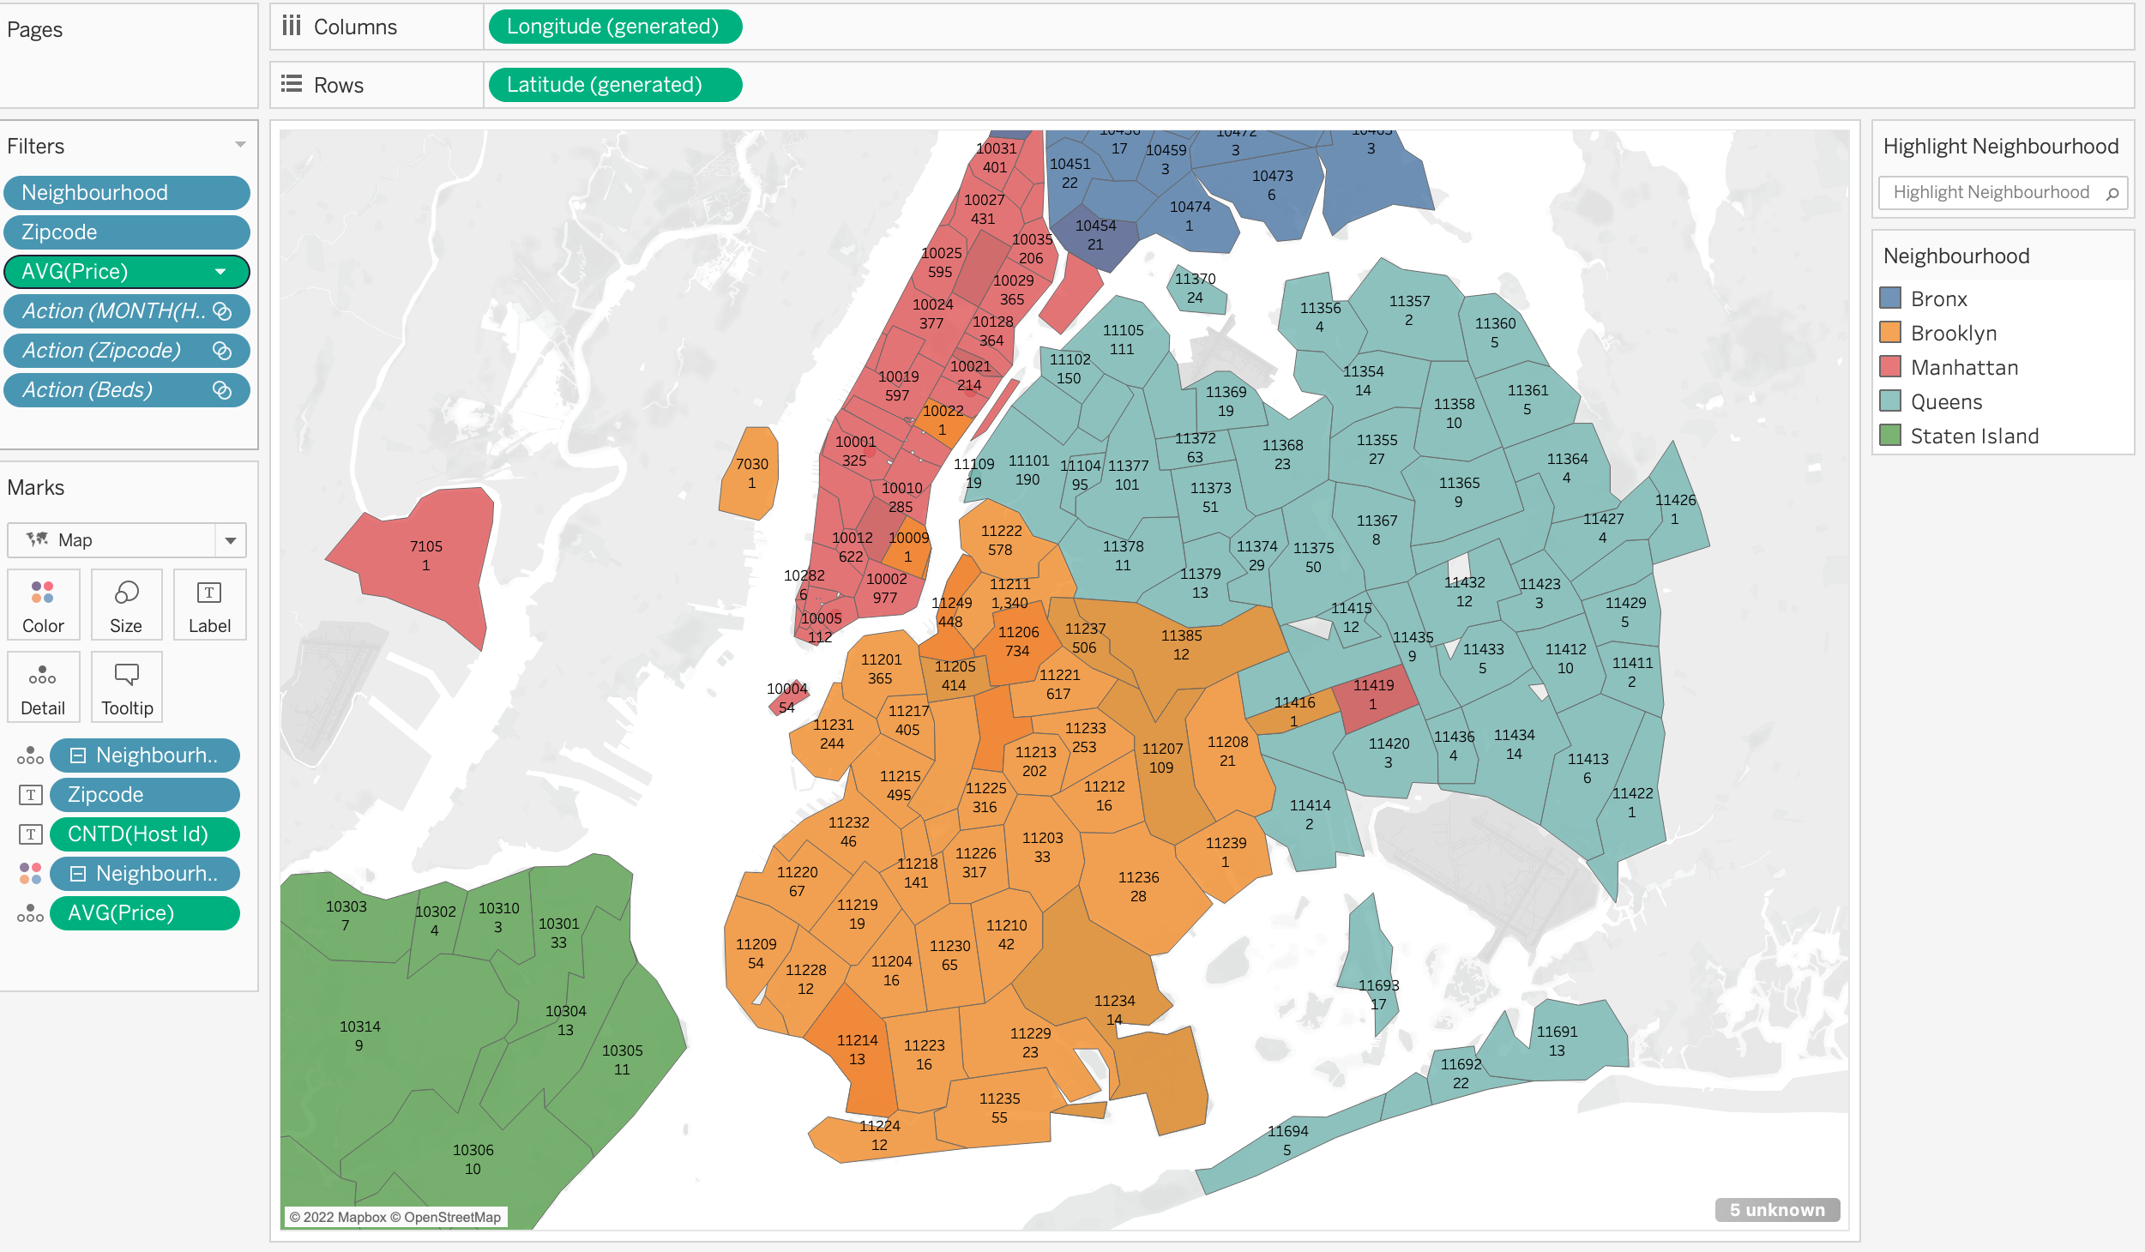
2nd : Number of listings around neighborhood?

Slide 6
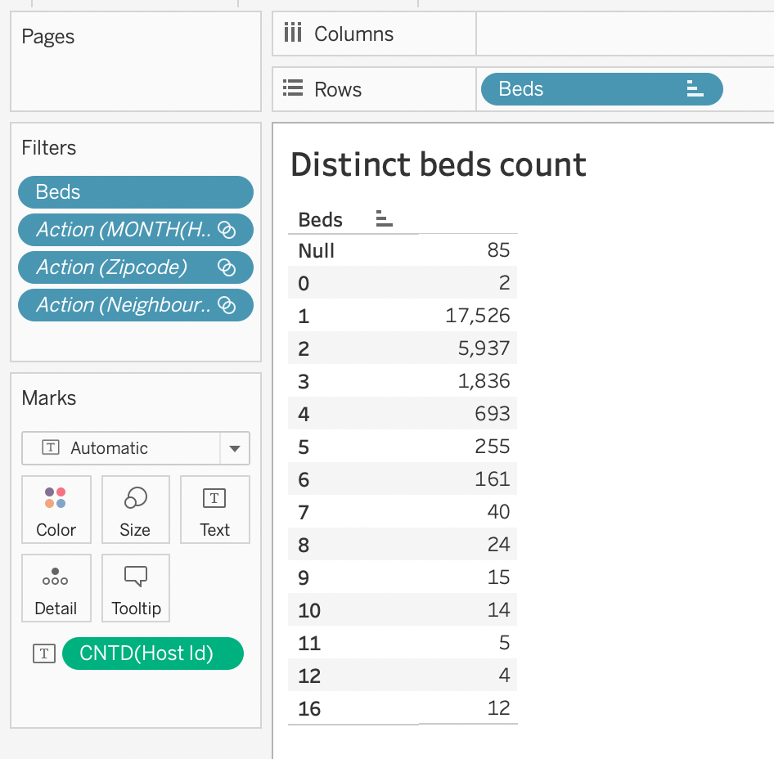
For 3rd Visualization : Other Property owners and the Bedrooms?

Slide 7
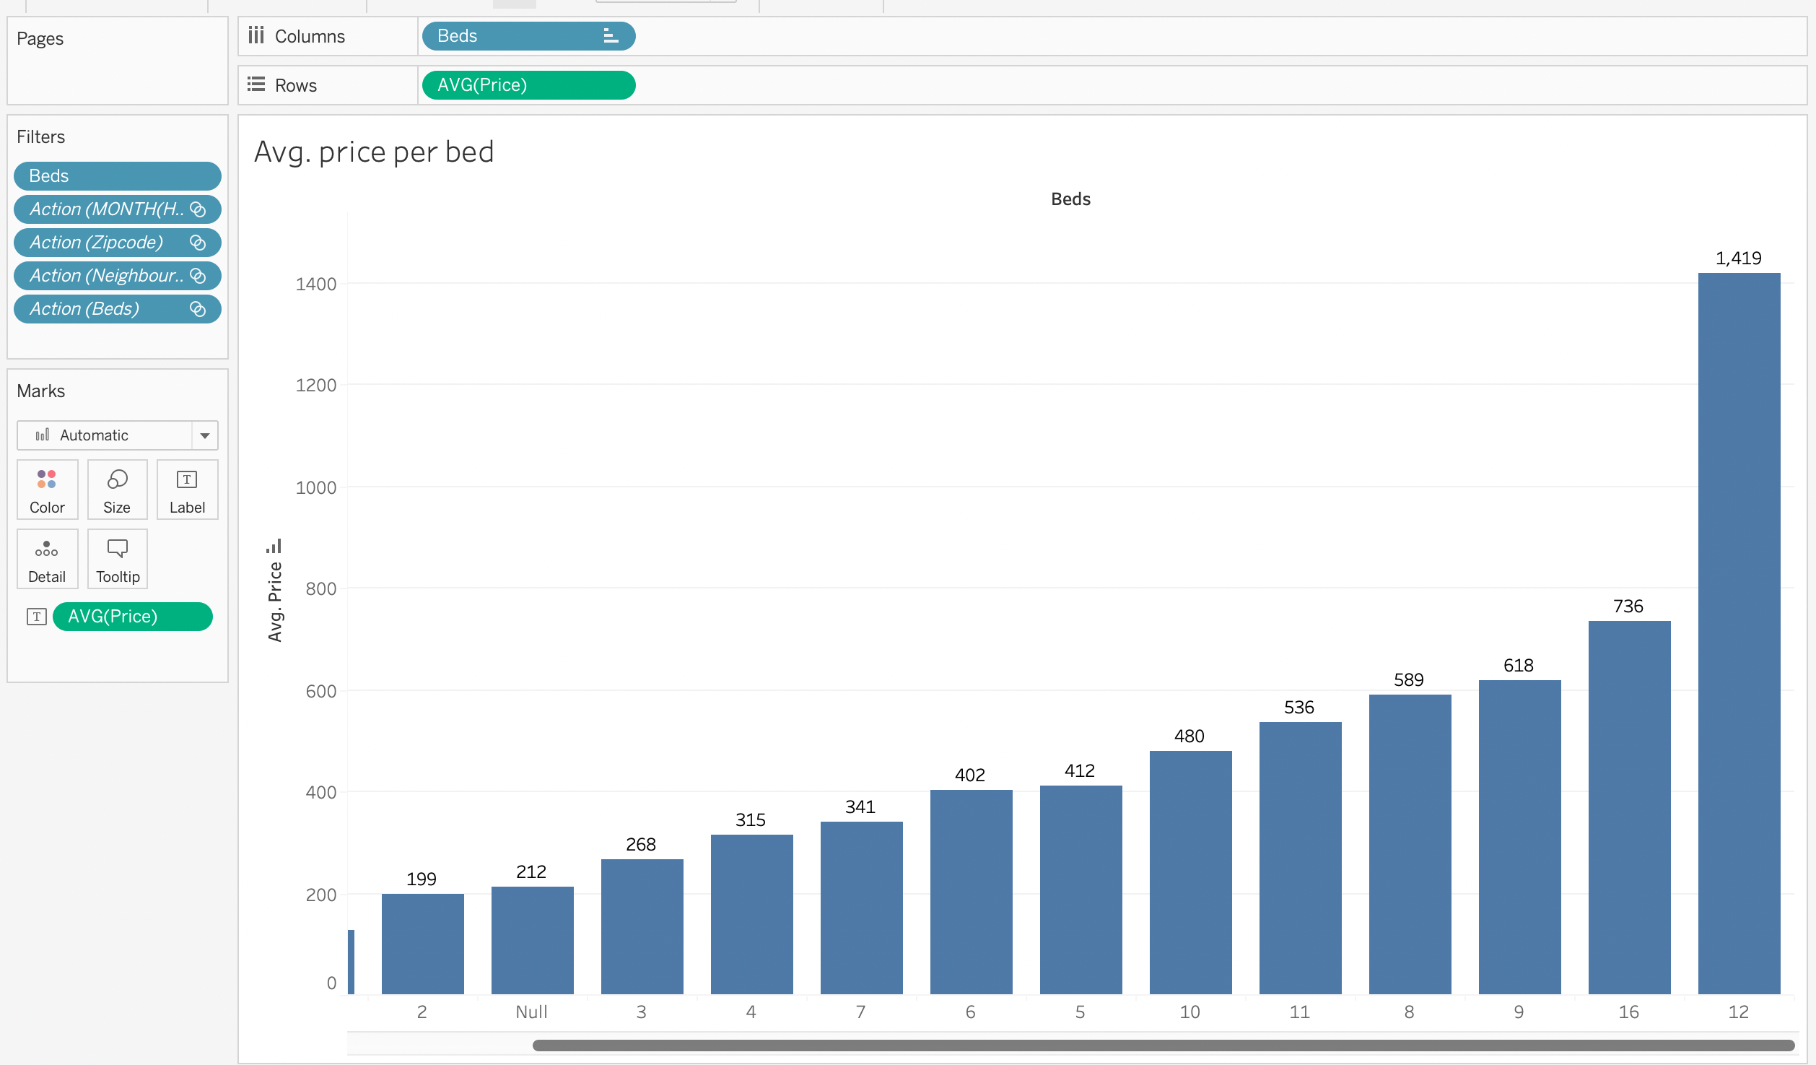
^{4th} : Number of bedrooms vs the price?

Slide 8
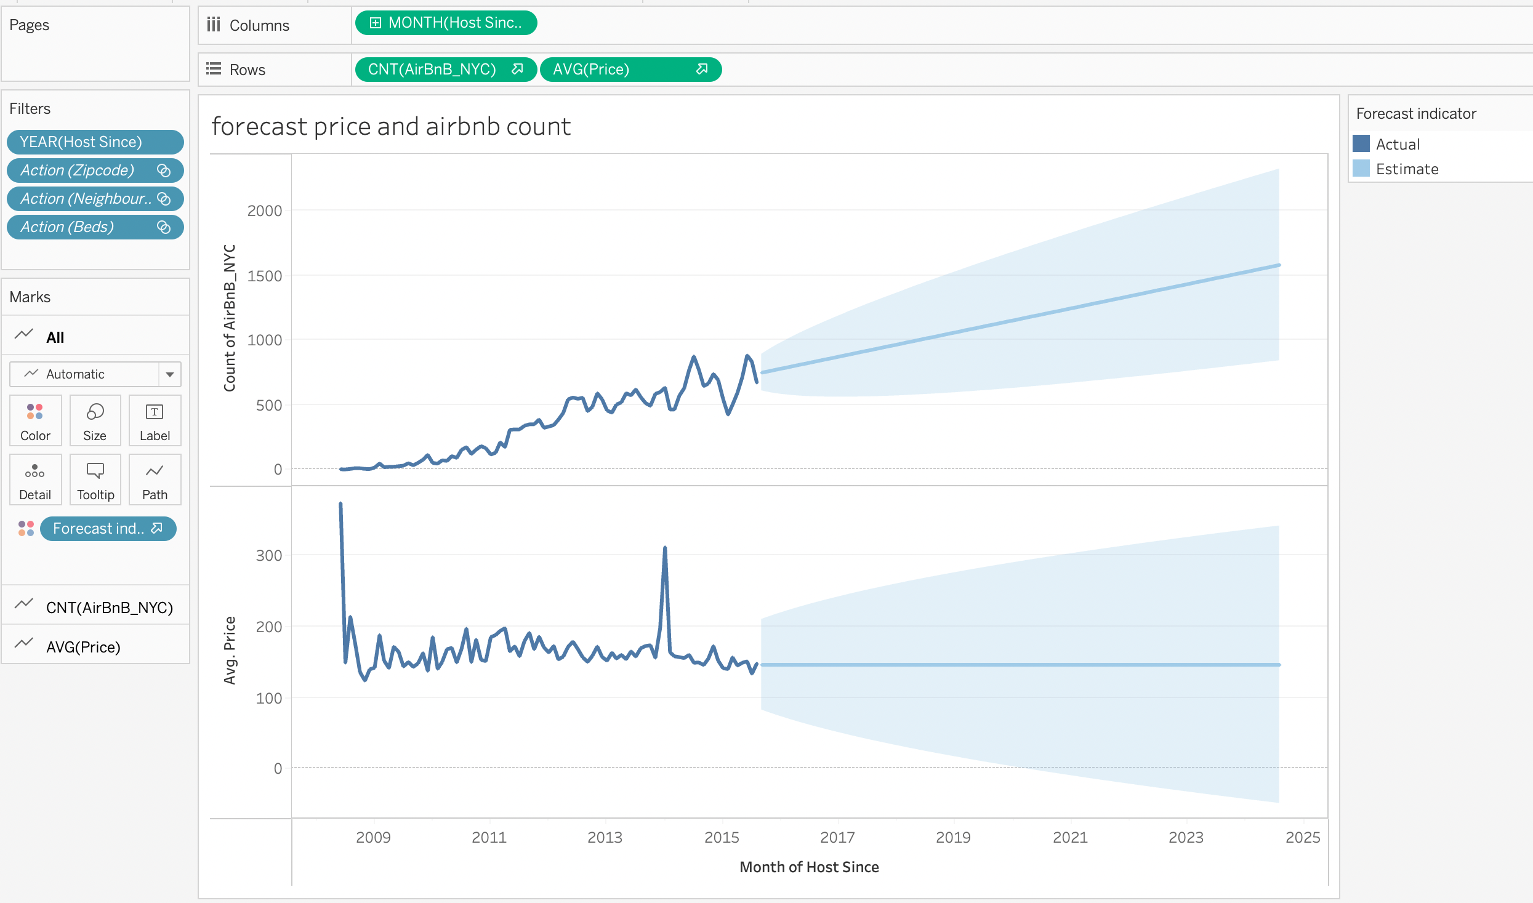
5th : Forecasting the price and Count of Airbnb’s

Slide 9
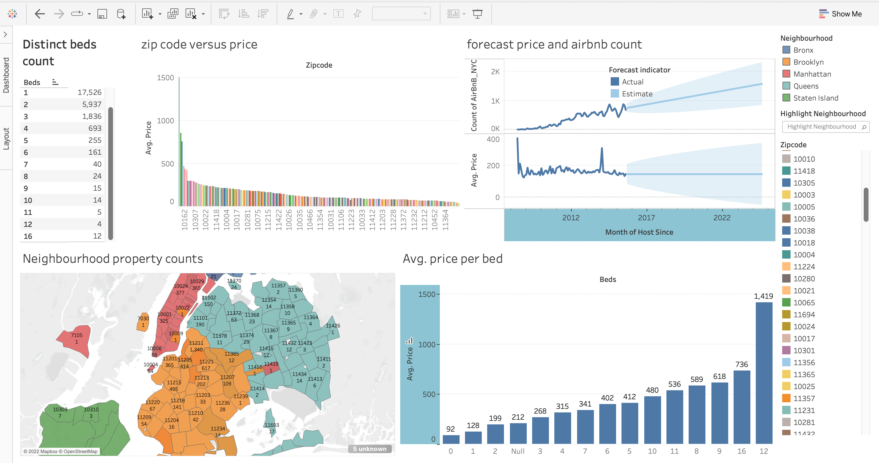
Final dashboard !!

Slide 10
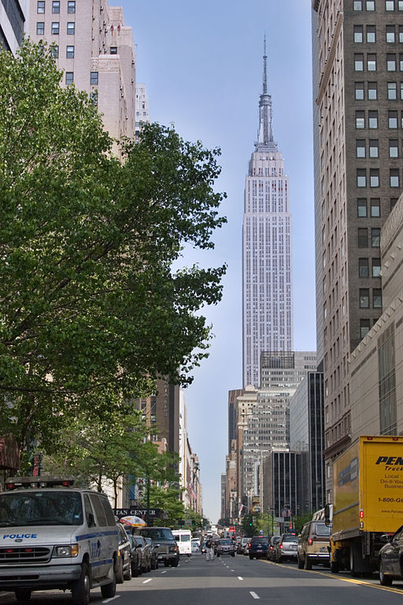
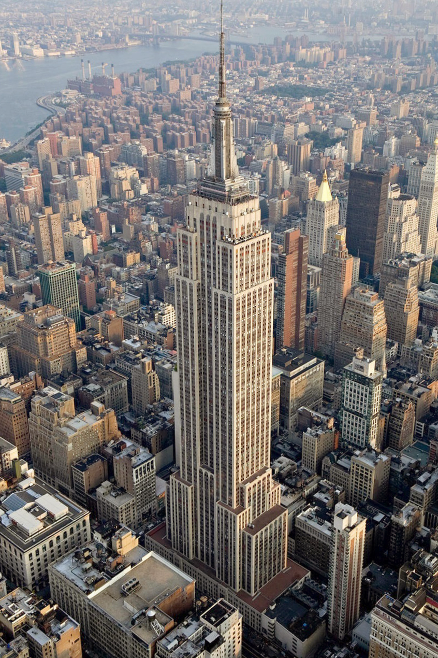
Outlier- 10119, NYC - $1500 average price
This Photo by Unknown Author is licensed under CC BY-SA
This Photo by Unknown Author is licensed under CC BY-SA

Slide 11
Top headlines on AIRBNB’s:
AIRBNB generated $ 5.9 billion in rev. in 2021 which is about 73% increase from the previous year because of covid.
In 2018 , there were 150 million people using Airbnb ( data has not been
since)
Acc. to April 2022 Survey, there are more than 10,500 short-term rentals available AIRBNB’s in NYC.

